Slide 1




Slide 2

Decision-making and Control structures
URL:https://forms.gle/eeUKnoLr6kuVMPPQ9
QR CODE:

Slide 3

INTRODUCTION TO ALGORITHMS

Slide 4
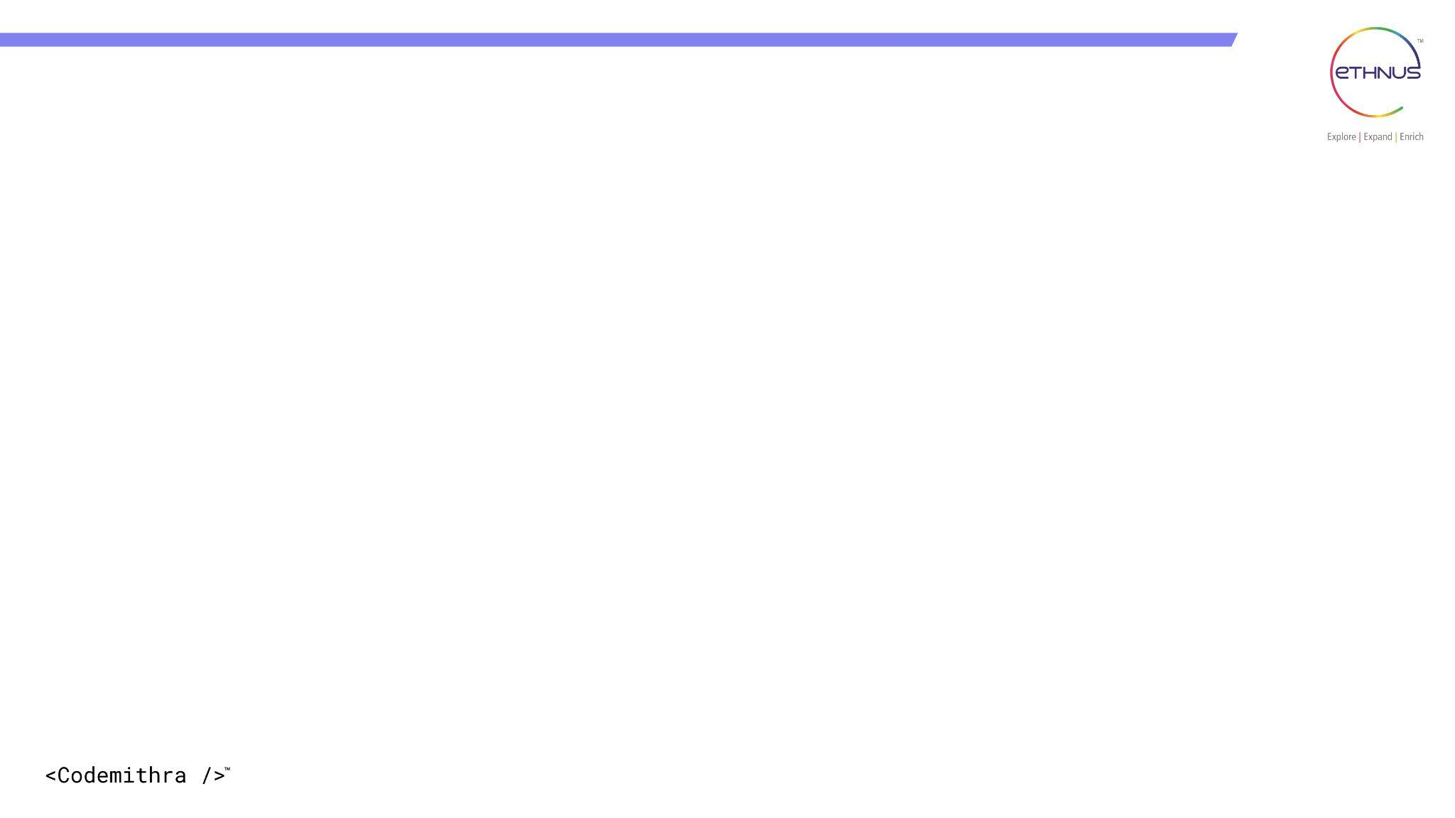

TOPICS
What is an algorithm?
Why do we need algorithm?
Characteristics of algorithm
Characteristics of algorithm in java
How to design an algorithm
How to analyze an algorithm
Types of algorithm

Slide 5
What is an Algorithm?
An algorithm is a step-by-step procedure or a set of instructions designed to solve a specific problem or perform a particular task. In computer science, algorithms are essential for developing efficient and effective software solutions.

Slide 6
Why Do We Need Algorithms?
1.Problem Solving: Algorithms provide a systematic approach to solving problems. They break down complex tasks into smaller, manageable steps, making problem-solving more organized and easier.
2. Efficiency: Well-designed algorithms can significantly improve the efficiency of a program. They help in optimizing resource usage and reducing execution time, which is crucial for large-scale applications and computationally intensive tasks.

Slide 7
Why Do We Need Algorithms?
3. Reusability: Algorithms can be applied to various scenarios and data, allowing code reusability and reducing the need to write similar logic multiple times.
4. Standardization: Algorithms provide a standard way to solve specific problems, promoting consistency and ensuring that different programmers can approach the same problem with similar techniques.

Slide 8
Characteristics of an Algorithm:
1. Input:
An algorithm should have zero or more inputs. These inputs are the data on which the algorithm operates.
2. Output:
An algorithm should produce at least one output. The output is the result of the algorithm's processing on the given inputs.
3. Definiteness:
Each step in the algorithm should be precisely defined and unambiguous, leaving no room for interpretation. This ensures that the algorithm's behavior is well-defined.

Slide 9
Characteristics of an Algorithm:
4. Finiteness:
An algorithm must eventually terminate after a finite number of steps. It should not run indefinitely or go into an infinite loop.
5. Effectiveness:
The steps in the algorithm should be basic and simple enough that they can be executed using basic operations or actions.

Slide 10
Characteristics of an Algorithm:
6. Correctness:
The algorithm should produce the correct output for all valid inputs and should solve the problem it was designed to address.
7. Determinism:
The algorithm's steps should be deterministic, meaning that given the same input and conditions, it will always produce the same output.
8. Feasibility:
The algorithm should be practical and feasible to implement, considering the available resources and computational power.

Slide 11
Characteristics of an Algorithm:
Syntax:
The algorithm should be expressed using the syntax and constructs of the Java programming language.
2. Data Structures:
Java provides various data structures like arrays, lists, maps, etc., that can be used to represent data and support algorithmic operations.

Slide 12
Characteristics of an Algorithm:
3. Object-Oriented:
Java is an object-oriented language, and algorithms can be designed using object-oriented principles like encapsulation, inheritance, and polymorphism.
4. Standard Library: Java's standard library offers a wide range of utility classes and functions, which can be leveraged to simplify algorithm implementation and improve code readability.

Slide 13
How to design an Algorithm :
1. Understand the Problem:
Begin by thoroughly understanding the problem you need to solve. Identify the inputs, desired outputs, and any constraints or special conditions.
2. Break Down the Problem:
Divide the problem into smaller sub-problems or steps. This process is called decomposition and helps make the problem more manageable.

Slide 14
How to design an Algorithm :
3. Choose a Suitable Data Structure:
Select the appropriate data structure to store and manipulate the data efficiently. Common data structures in Java include arrays, lists, sets, maps, and trees.
4. Design the Algorithm:
Start designing the step-by-step procedure to solve the problem. Use pseudocode or flowcharts to outline the logic without worrying about the specific syntax of the programming language.

Slide 15
How to design an Algorithm :
5. Implement the Algorithm:
Translate the algorithm into Java code using the correct syntax, data structures, and control structures like loops and conditionals.
6. Test and Debug:
Test the algorithm with various inputs, including edge cases, to ensure it produces the correct output. Debug and refine the code as needed.

Slide 16
How to analyze Algorithm :
Algorithm analysis involves evaluating the efficiency and performance of an algorithm. The primary aspects of algorithm analysis include:
1.Time Complexity: Measure how the algorithm's running time increases with the size of the input data. Common notations used are Big O notation (e.g., O(n), O(n^2)).
2.Space Complexity: Evaluate the amount of memory space required by the algorithm as a function of the input size.

Slide 17
How to analyze Algorithm :
3.Best, Average, and Worst Cases: Analyze the algorithm's performance in different scenarios, such as best-case (minimum time required), average-case (expected time), and worst-case (maximum time required).
4.Asymptotic Analysis: Focus on the growth rate of the algorithm's time and space requirements as the input size becomes very large. This helps identify the most significant factors affecting the algorithm's performance.

Slide 18
Types of Algorithms :
Sorting Algorithms:
Algorithms to arrange elements in a specific order, like Bubble Sort, Selection Sort, Insertion Sort, Merge Sort, Quick Sort, etc.
2. Searching Algorithms:
Algorithms to find a particular element in a data structure, like Linear Search, Binary Search, etc.
3. Graph Algorithms:
Algorithms to solve problems related to graphs, like Depth-First Search (DFS), Breadth-First Search (BFS), Dijkstra's Algorithm, etc.

Slide 19
Types of Algorithms :
4. Dynamic Programming Algorithms:
Techniques to solve complex problems by breaking them down into overlapping sub-problems, like Fibonacci sequence, Knapsack problem, etc.
5. Greedy Algorithms:
Algorithms that make locally optimal choices at each step, aiming to find a global optimum, like Huffman Coding, Kruskal's algorithm, etc.

Slide 20
Types of Algorithms :
6. Backtracking Algorithms:
Algorithms that explore all possible solutions through a recursive trial-and-error approach, like N-Queens problem, Sudoku solver, etc.
7. Divide and Conquer Algorithms:
Techniques that break a problem into smaller sub-problems, solve them independently, and combine their results to get the final solution, like Merge Sort, Quick Sort, etc.

Slide 21
INTERVIEW QUESTIONS

Slide 22
Interview questions
1. What is the significance of algorithms in problem-solving?
Algorithms provide structured approaches to solving problems efficiently and consistently, ensuring reliable results.

Slide 23
Interview questions
2. How would you define the characteristics of an algorithm?
An algorithm must have finiteness, definiteness, input, output, effectiveness, and generality.

Slide 24
Interview questions
Interview questions
3. Can you explain the steps involved in designing an algorithm?
Algorithm design includes understanding the problem, planning, specifying, verifying, and implementing the solution.

Slide 25
Interview questions
Interview questions
4. Why is algorithm analysis important?
Algorithm analysis helps determine the efficiency of an algorithm in terms of time and space complexity.

Slide 26
Interview questions
Interview questions
5. Differentiate between time complexity and space complexity.
Time complexity measures how an algorithm's execution time increases with input size, while space complexity measures its memory requirements.

Slide 27




THANK YOU
+91 78150 95095
codemithra@ethnus.com
www.codemithra.com

